Slide 1
WELCOME Framework for B-BBEE Implementation

Slide 2
Program
1. Opening and welcome
2. Framework for BEE verification, rating and implementation by Mr. Andile Tlhoaele
-Amended Generic Codes -Scorecard, Recognition Level and B-BBEE Status
-Framework for BEE verification :What verification companies look for
3. Implementation of Priority Elements:
- Ownership and Preferential Procurement – Ms. Mpho Sedibe
- Enterprise and supplier development- Mr. Keith Matthews
4. Framework for implementation: B-BBEE 123 tool- Saul Symanowitz
5. Panel Discussion
6. Demo of SANEC BEE website
7. Closure

Slide 4
by SANEC Sekga, overview of B-BBEE Desk
Notes:
B-BBEE Overview plus SANEC

Slide 5
SANEC BBBEE Desk Seminar
Friday, 26 June 2015

Slide 6
Who we are
MOPSY Strategic Advisors is a 100% black female independent, niche consultancy dedicated to:
Making a tangible contribution to advancing the economic emancipation of historically disadvantaged individuals, by collaborating with key corporate decision makers to introduce meaningful and sustainable transformation solutions that address both the corporate transformation agenda, as well as South Africa’s need to economically evolve
MOPSY Strategic Advisors is owned and actively managed by a group of passionate and talented black South Africans committed to making a meaningful and tangible contribution to creating economic value within small business. Together, the team has more than 14 years of relevant industry experience in banking, asset management, management consulting, and business consulting. MOPSY Strategic Advisors is also supported by a multi-disciplinary advisory team of successful entrepreneurs and corporates.
Notes:
BBBEE programme advisory
Division Strategy for divisions within large corporates
Industry trends analysis
Xxxx

Slide 7
What we do
BBBEE strategic advisory
Strategic advisory
SMME advisory
Provide strategic support to the senior leadership on the impact of BBBEE decisions on the business
Integrate Transformation strategy and corporate strategy to ensure alignment
Scenario test individual scorecard elements to determine the maturity of each element
Designing Transformation glide paths for each element, and for the business as a whole to achieve a desired level over time
Detailed scorecard element strategy and contributing programme design
Designing measurement and evaluation tools to monitor the impact of recommendations
Due diligence
Market research reports
Foreign entry partnerships
Market entry strategies
Productivity benchmarking and Lean improvement
Transfer skills and build capabilities in finance and value creation as part of enterprise development plans
Equip SMMEs with toolkit to develop EMEs within their supply chains – Ubuntu in Business
Identify partnership synergies between SMMEs and other corporate entities
Notes:
BBBEE programme advisory
Division Strategy for divisions within large corporates
Industry trends analysis
Xxxx

Slide 8
How we do it: BBBEE strategic advisory
We follow an 8-step process in our BBBEE strategic advisory:
Post conduction of an impact assessment, we model scenarios to identify different levers that a client can pull to improve their BBBEE score
We then agree with the client on a realistic aspirational BBBEE target
We carry out a thorough diagnostic of existing programmes and identify opportunities to scale these
We collaborate with the client to design a full suite of programmes to capture the opportunities identified in the scorecard. Here we work very closely with the client's transformation team to ensure maximum skills transfer and continuity
Having agreed on programmes to run, we help the client set up a project management office to drive programme delivery. It is encouraged that this be driven by the client's current resources, to ensure cost effectiveness
Upon programme kickoff, we monitor progress to ensure that the programme is performing in line with expectations, and we would incorporate course correction strategies as we gather insights from the programme roll out
We then compile interim ratings, similar to what a rating agency would do. We also help the client prepare for their next rating and challenge rating agencies should the determined rating fall below expectations
Partnering with an enterprise technology company, we also implement systems to ease the burden of BBBEE data gathering and scenario testing going forward. The tool also makes pulling interim reports much easier. The incorporation of technology solutions is entirely at the option of the client
Notes:
BBBEE programme advisory
Division Strategy for divisions within large corporates
Industry trends analysis
Xxxx

Slide 9
Priority element: Ownership
Top of mind for the DTI
Meaningful broad-based inclusion in ownership i.e. directly holding equity, voting rights
Economic value of equity participation i.e. voting rights, participation in dividends, share value appreciation in relation to the financing provided to acquire the shares, the release from third party obligations
Broad beneficiary base which may include designated groups (e.g. black unemployed, youth, living with disabilities, rural/under-developed, military veterans), broad-based ownership schemes (e.g. communities) and broad-based employee schemes (i.e. fixed allocation, linked to performance)
Additional benefits for bringing in new entrants (i.e. black participants who have not participated in the equity of another entity to the value of a minimum of R50m)
There is a flow-through that may accrue due to the sale of assets, but this is dependent on who the asset is sold to. The onus is on the Measured Entity to track the hands the shares are in
Business should focus on inclusive, value adding schemes that allow black people the opportunity to make an economic contribution to the measured entity through their shareholding

Slide 10
Priority element: Preferential Procurement
Increased focus on localisation through Empowering suppliers
Local production (25%), local labour (25%), local cost base (minimising imports – 25%), skills development of local labour,
For all categories within Preferential Procurement, suppliers must first be Empowering before any recognition will be granted
EMEs are automatically deemed to be Empowering
Deliberate creation of opportunities for both emerging businesses, and businesses with black ownership with 80% of available points set aside for that cause
7/25 points (approx. 30%) set aside for EMEs and QSEs contributing 15% to TMPS
9/25 points (approx. 35%) set aside for businesses that are black owned contributing 40% to TMPS
4/25 points (approx 15%)set aside for businesses that are at least 30% black female owned contributing 12% to TMPS
Businesses should take a long term view of looking at how to shift Procurement spend to preferential suppliers in a way that doesn’t compromise on operational effectiveness and profitability. Supplier Development is an important lever to execute the shift in Procurement spend.

Slide 11
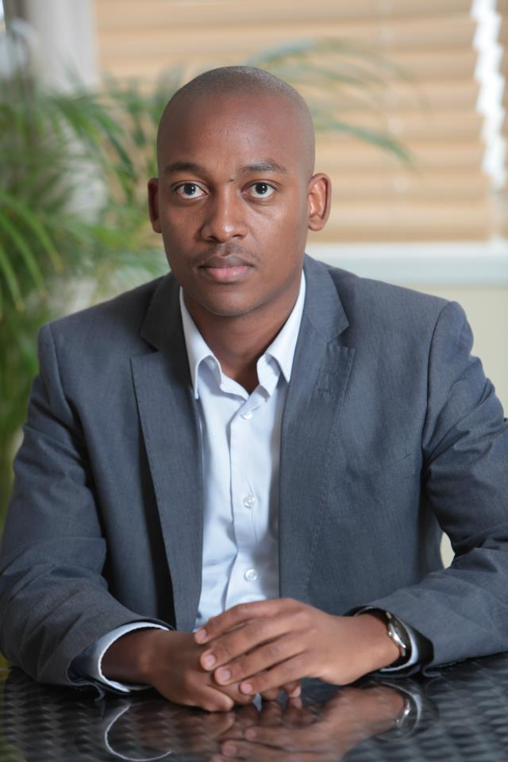
Leadership CVs
Mpho Sedibe, CA(SA)
Zweli Gwebityala
Educational backaground
SAICA, January 2012
University of Johannesburg, 2005 – 2008
BCom Accounting (Honours)
Wits University , 2006 - 2008
Bachelor of Economic Sciences
Work experience
MOPSY– Managing Director
McKinsey and Company – Associate
Allan Gray – Institutional Client Servicing Business Analyst
Investec Bank – TOPP CA(SA) programme
MOPSY – Partner
McKinsey and Company – Senior Associate
Barclays Africa – Project Manager
Standard Bank – Operations improvement Manager
Example projects
BBBEE strategy for FMCG multinational – SA
Employment Equity modelling – SA
Capital project portfolio optimisation for Transport client – SA
HR strategy design for Energy client – SA
Manager development programme design for Energy multinational - SA
BBBEE strategy for FMCG multinational – SA
Bank revenue improvement and cost cutting – Nigeria, Ghana, Kenya and Togo
Investor readiness prepation for IT startup – Ghana
Capital project portfolio optimisation – SA
Data centre strategy – SA
Notes:
BBBEE programme advisory
Division Strategy for divisions within large corporates
Industry trends analysis
Xxxx

Slide 12
Contact details
MISS MPHO SEDIBE
MANAGING DIRECTOR: MOPSY STRATEGIC ADVISORS
TELEPHONE: +2783 765 6115
EMAIL: mpho@mopsy.co.za
MR ZWELI OYENA GWEBITYALA
PARTNER: MOPSY STRATEGIC ADVISORS
TELEPHONE: +2776 235 5839
EMAIL: zweli@mopsy.co.za

Slide 14
Thank you

